Slide 1
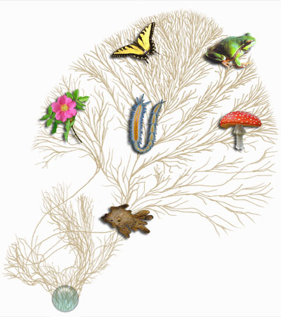
Classification & the New Taxonomy

Slide 2
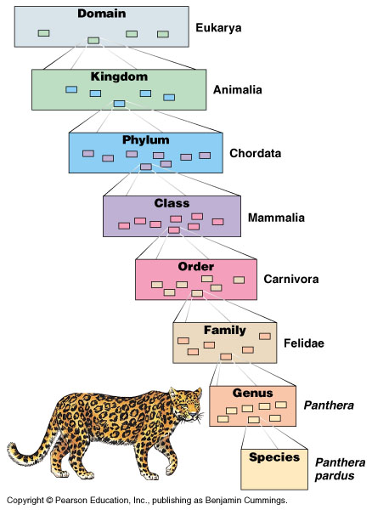
Classification
Solar System
Organisms classified from most general to most specific
domain, kingdom, phylum, class, order, family, genus, species
Earth
N. America
U. S.
MN
Meeker Co.
Litchfield
use a mnemonic!
901 N. Gilman Ave.

Slide 3
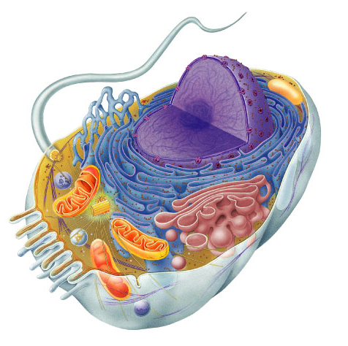
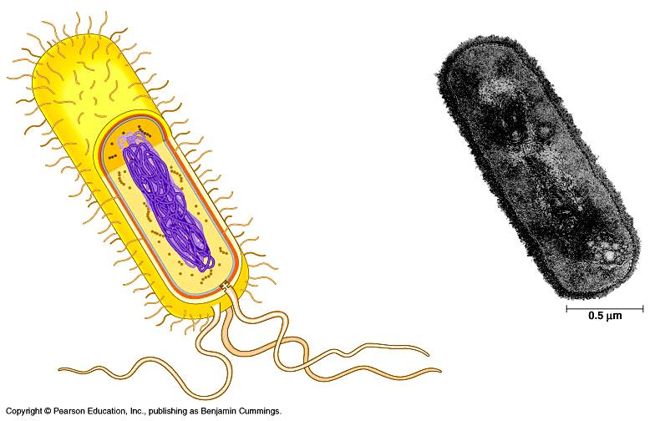
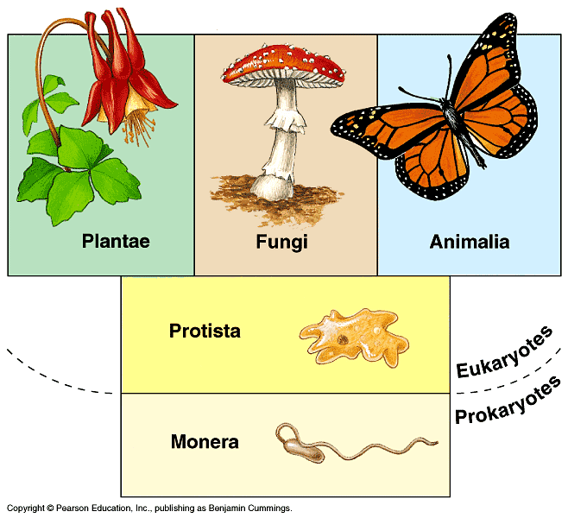
Classification
Eukaryote
Old 5 Kingdom system
Monera, Protists, Plants, Fungi, Animals
New 3 Domain system
reflects a greater understanding of ev. & mol. evidence
Prokaryote: Bacteria
Prokaryote: Archaebacteria
Eukaryotes
Protists
Plants
Fungi
Animals
Prokaryote
Archaebacteria & Bacteria

Slide 4
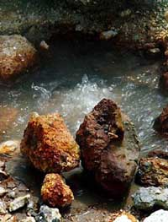
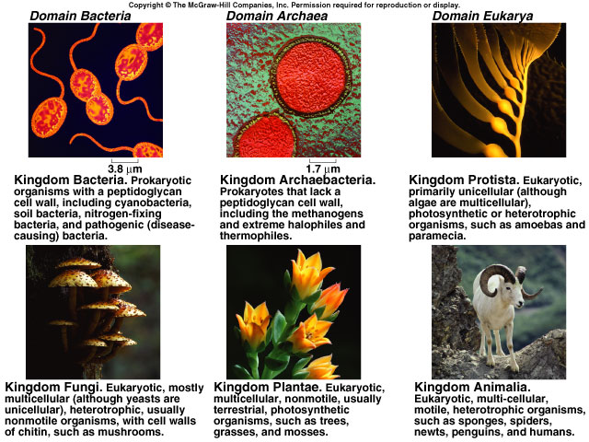
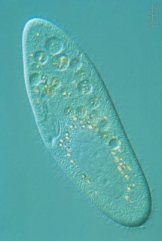
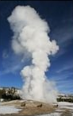
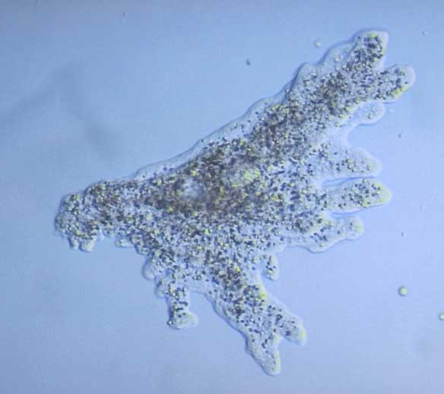
Kingdom Bacteria
Kingdom Archaebacteria
Kingdom Protist
Kingdom Fungi
Kingdom Plant
Kingdom Animal

Slide 5
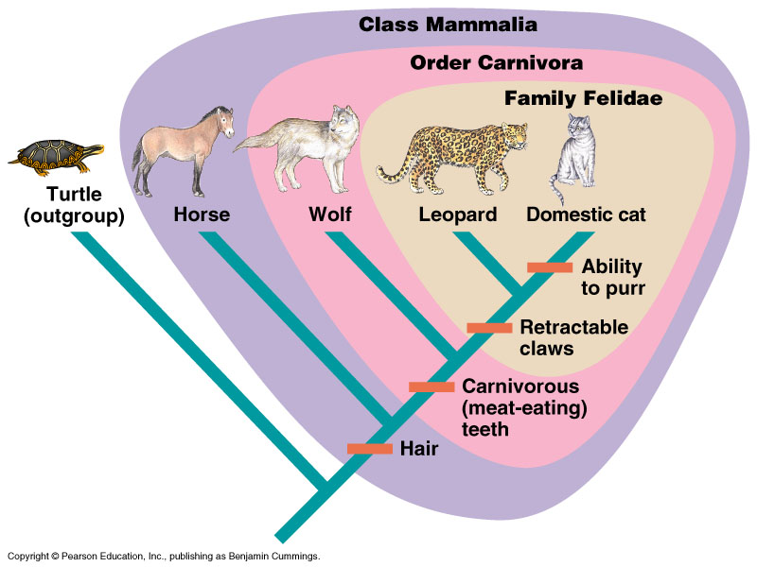
The Evolutionary Perspective

Slide 6
The Evolutionary Perspective
Arch. and Euk. more closely related to each other than to Bact.

Slide 7
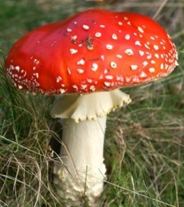
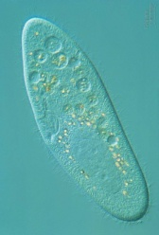
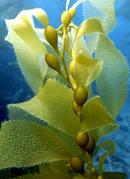
Kingdoms
Fungi
Animalia
absorptive nutrition
ingestive nutrition
Plantae
autotrophs
heterotrophs
Protista
uni- to multicellular
multicellular
Eubacteria
Archaebacteria
prokaryotes
eukaryotes
Single-celled ancestor

